Slide 1

Singleness
Northampton Methodist District
Representative Session of the Synod
10th May 2025

Slide 2
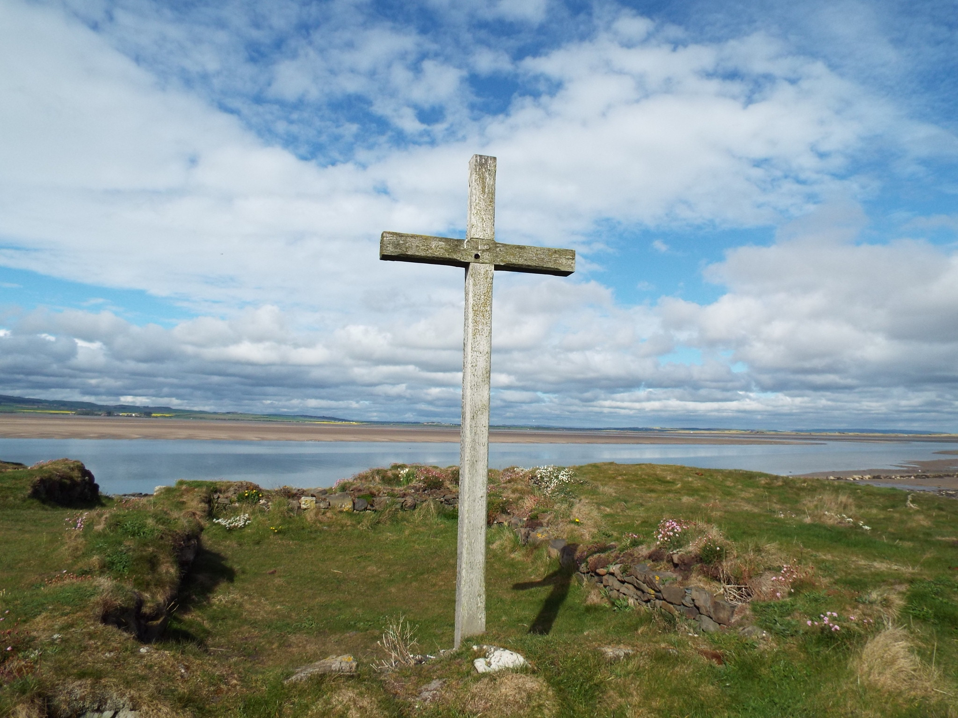
“The Church still has much to do in welcoming, affirming and celebrating the presence, participation and contribution of single people.”

Slide 3
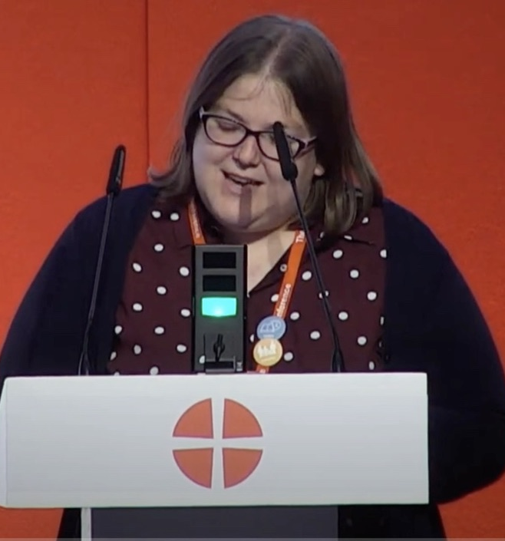
A request for further work on Singleness
Methodist Conference 2022 – Notice of Motion
The NOM asked for more work to be undertaken on Singleness, given that the Methodist Church’s previous statement on the single life had been published in 1992 in the Conference Statement, ‘A Christian Understanding of Family Life, the Single Person and Marriage.’
The aim was to raise awareness, challenge assumptions and offer resources for individuals and churches to grapple with what full inclusion for single people (never married, divorced, separated, widowed) might look like.

Slide 4

Why does this work matter?
Statistics indicate that in the UK around 40% of the population are single, through choice or circumstance. Some have never married, those who are divorced, separated or widowed, and those whose status continues to shift. These demographics are, of course, reflected in the life of the Methodist Church.
But have you or your church ever really thought about the full inclusion of those who are single?

Slide 5
In agreeing its Justice, Dignity and Solidarity Strategy, the Methodist Church committed to celebrating diversity, eradicating all discrimination, and bringing about a profound change in the culture, practices and attitudes of the Church.
What might full inclusion of single people in the life of the church look like?

Slide 6
But most of all this matters because of the experiences of people. God’s beautiful diverse creation and remembering that ‘every person has infinite value before God.’
Sadly this is not the experience of all single people in the life of the Church…

Slide 7
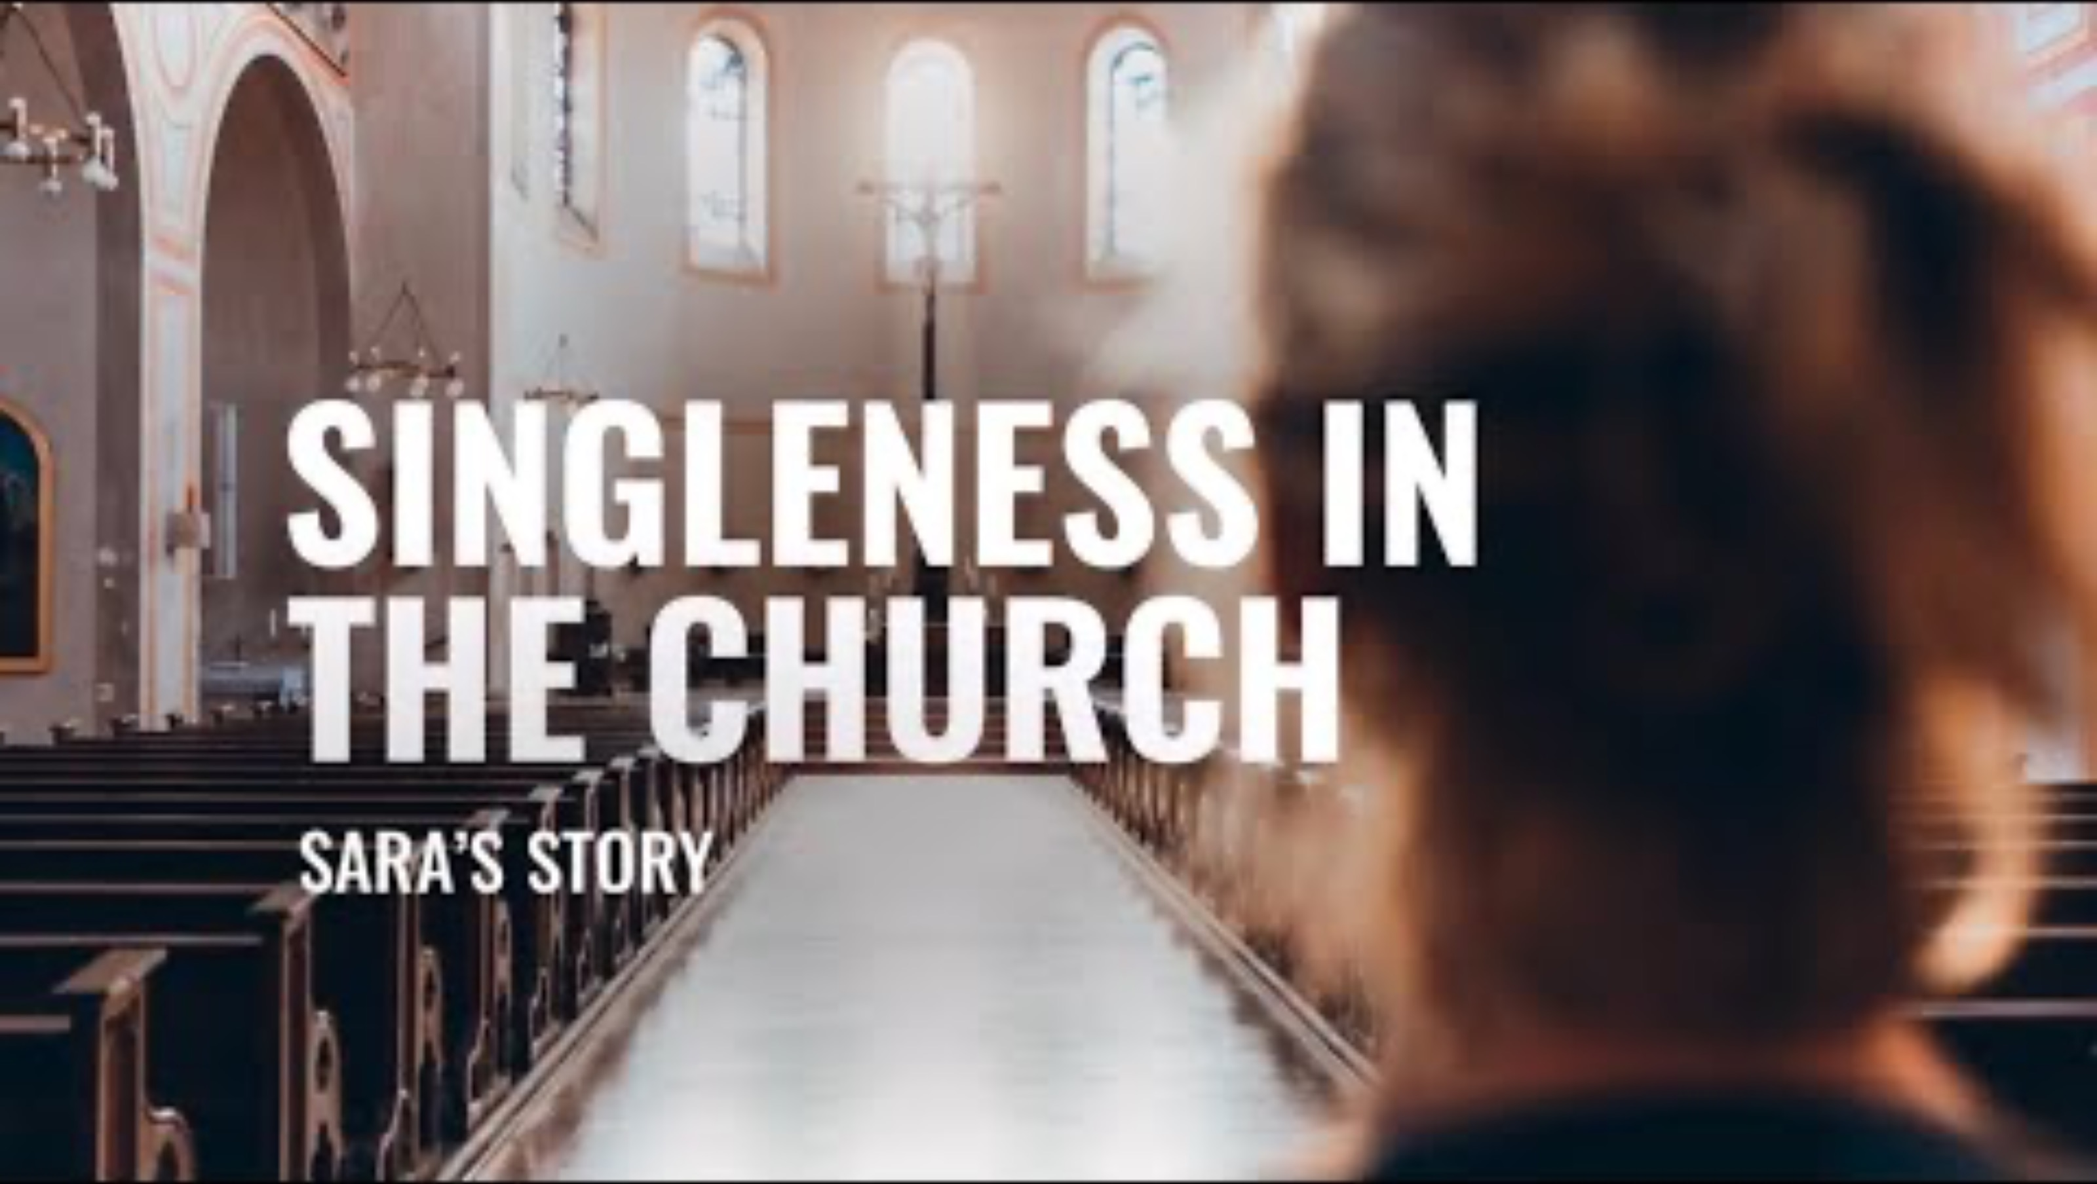

Slide 9
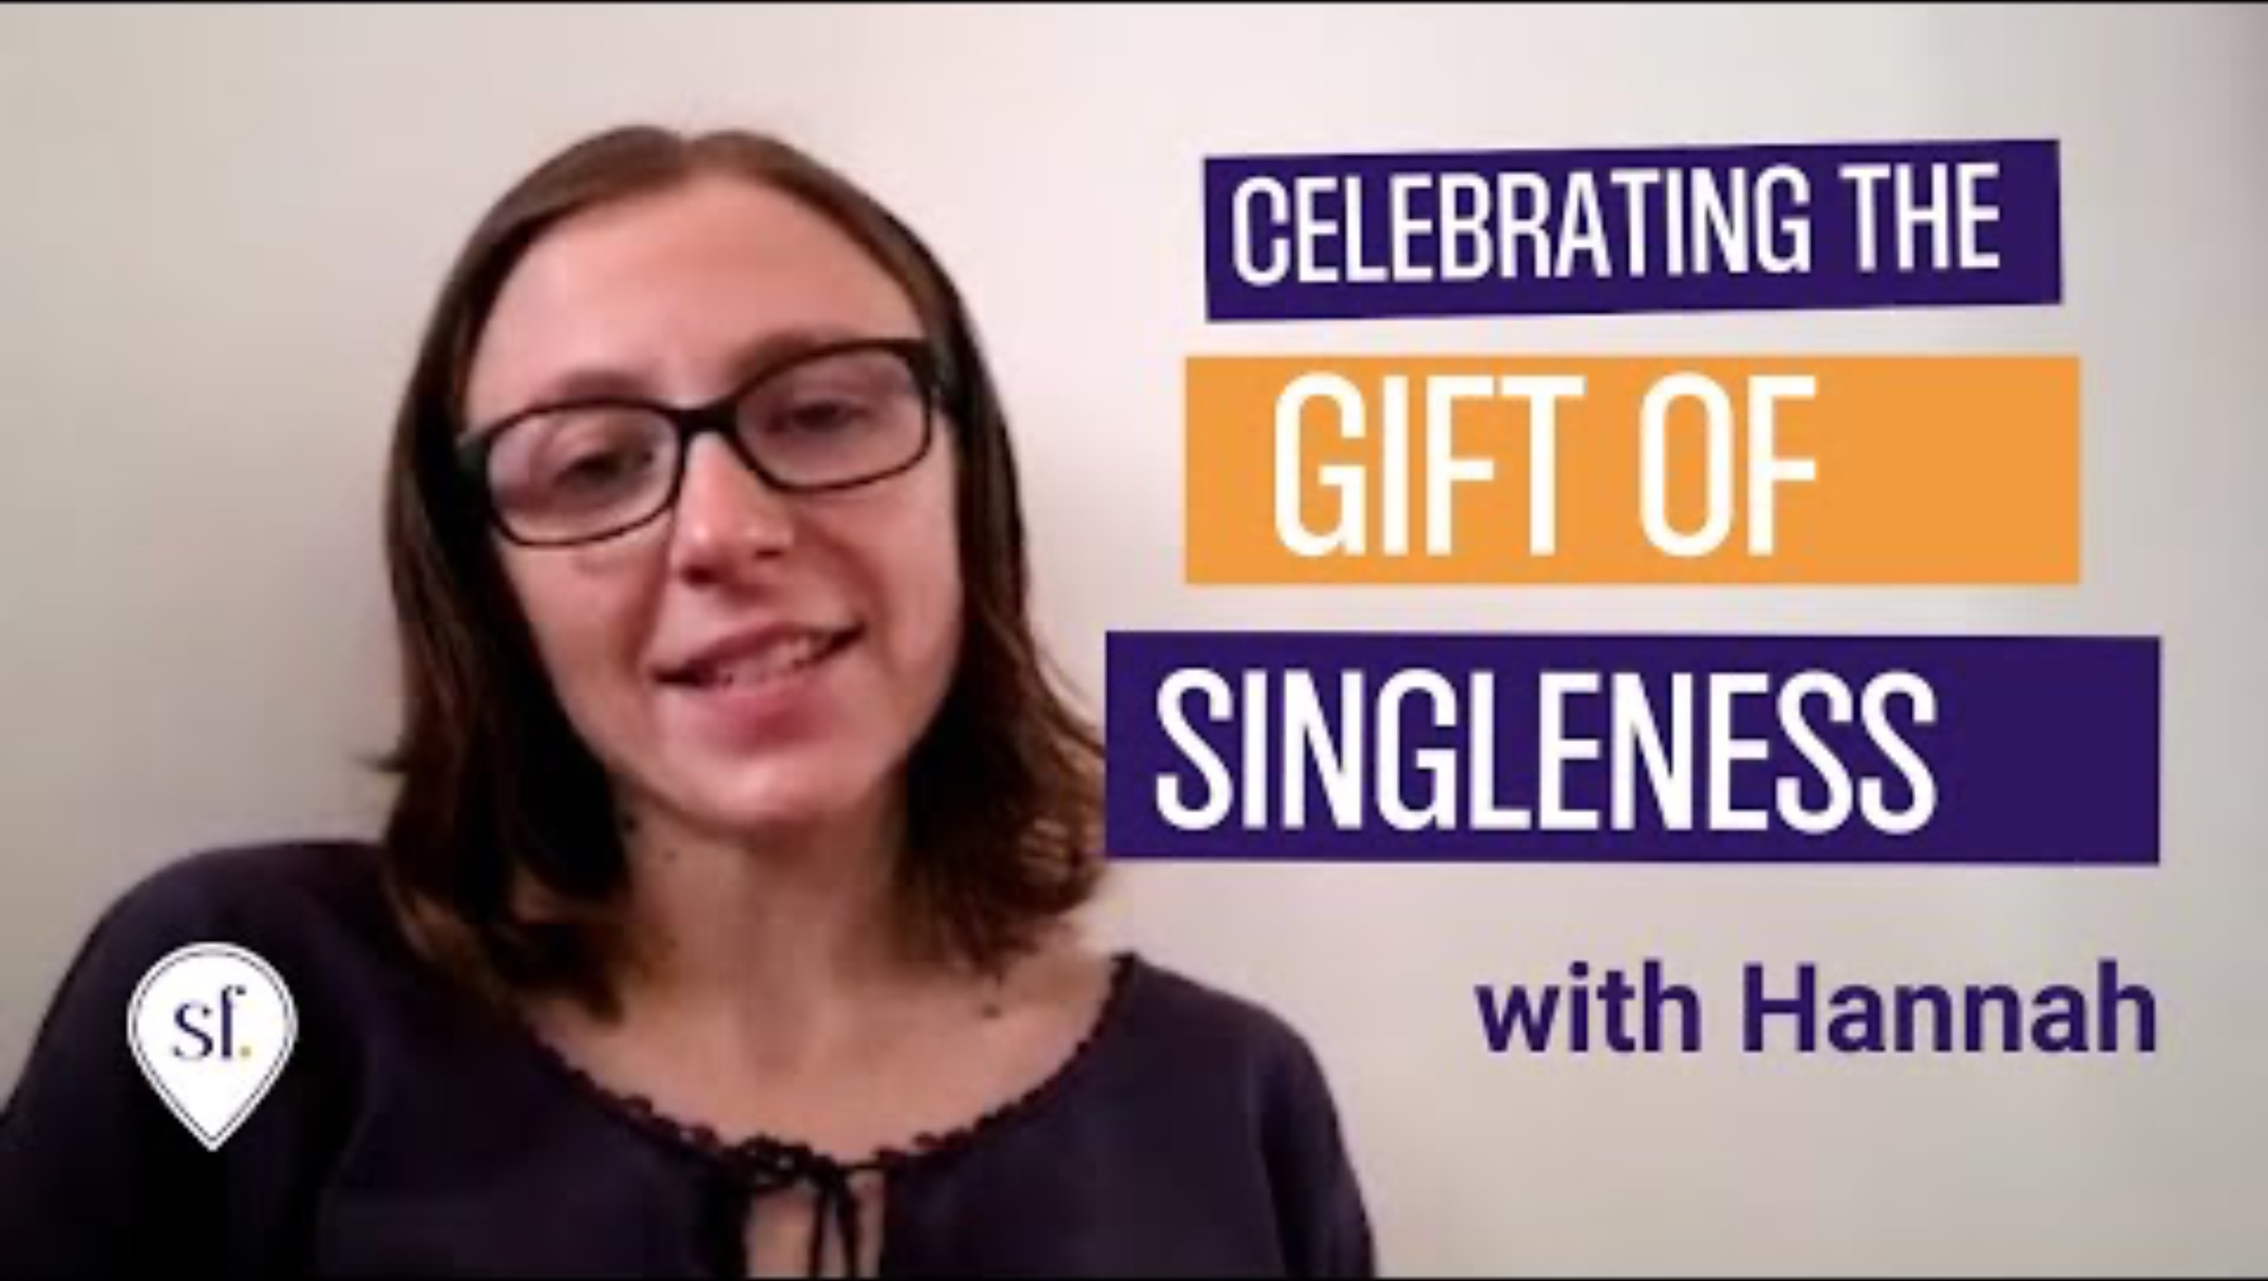

Slide 10
Experiences of single people
“I have faced the shock of a congregation member who met me in the supermarket – it had never occurred to them that I would have to do ‘that sort of thing.’ It became clear that they also didn’t realise that I had to cook my own dinner, clean the Manse and manage the garden!”
“Conversely there has been the assumption that I will be available at all hours and on days off because I ‘have no family’, something which is profoundly untrue – I have no children but do have a large and scattered family.”
“At the other end of the scale is the seemingly innate assumption that my life is somehow less rich because I do not have a partner and that my goal must be to meet someone and have children.”
“People seem to think it is appropriate to make comments like ‘When are you getting married?’ ‘How are you still single?’ ‘We need to find you a man!’ (LE 2025)

Slide 11
A lay member’s story (shared with permission)
“After my separation from my husband and our subsequent divorce, I was left to bring up my 2 year old daughter alone. I had hoped that church would be a loving and safe space for me in the midst of the trauma. However, sadly this was not the case. People didn’t know what to say to me so they didn’t speak to me at all. I felt like a pariah and as if I had done something wrong. That it was my fault. I started to attend church less frequently.”

Slide 12
Further experiences
of single people in church

Slide 13
The Singleness Report (2024) and some highlights
The Faith and Order Committee brought a report on Singleness to the Conference of 2024.
It includes an introduction, some biblical insights, some resources from Methodist History and some practical guidance. It is hoped that this will be just the beginning of conversations around this issue.

Slide 14
Practical guidance from the Report
The Committee suggested that Local Churches might:
Reflect on who is single within congregations:
Think about different forms of singleness and differing needs.
Each person will have their own needs and experience of singleness. As always, we need to be looking at the whole person, loved and valued children of God.
Always seek to avoid unhelpful assumptions about the circumstances and experiences of others.

Slide 15
Reflect on inclusion:
How are those who are single welcomed into your congregation?
Are single people included in the social life of the church?
What might it mean to move beyond welcoming single people to their full belonging and participation?
Reflect on language:
What messages are we giving out in our publications, through our social and other media, through posters on our walls, our newsletters and other communications?
How is the word ‘family’ used within the church?
What messages about relationships are preached upon?
Are there sometimes unhelpful assumptions made of a ‘normative’ position in our language? How might these be countered?

Slide 16
d) Reflect on leadership:
How is the demographic of your congregation reflected in your leadership?
How might everyone be encouraged to identify their gifts and serve God in the church?
e) Be attentive to events that may be more difficult for those who are single:
Mothering Sunday
Father’s Day
‘Family services’
Parenting or Marriage courses

Slide 17
Time for conversation

Slide 18
Conversation starters:
What has struck you most about the presentation?
Have you encountered some of the unhelpful assumptions outlined? As far as you feel comfortable, share those experiences.
How are those who are single welcomed into your congregations?
What messages is your church giving out in publications, through media, posters, newsletters? How do you use the word ‘family’?
What do you think it might mean in your church to move beyond welcoming single people to their full belonging and participation?
What is one thing that you might take away from today’s conversation and do differently?

Slide 19
Opportunity for Feedback

Slide 20
Resources
Single Friendly Church – audit resources available
https://www.singlefriendlychurch.com/news-and-resources/new-and-improved-guided-audit
Please read the Singleness Report (2024) and share the findings in your local Church.
https://media.methodist.org.uk/media/documents/conf-24-pc-17-singleness.pdf
If I personally can be of help in your conversations do make contact!

